Slide 1


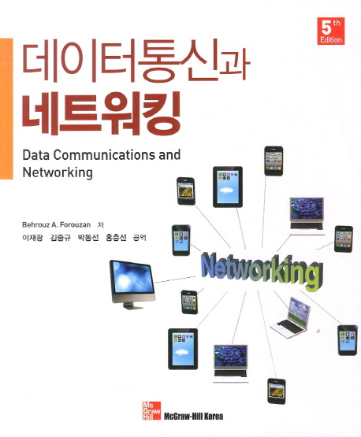
Computer Network
Kyungpook National University
School of Computer
Prof. Kim, Jae Soo

Slide 2
Summary Of the Class
Course Title : Data Comminication
Credits : 3-3-0, Major in Engineering
Class Hours : Mon. 7A~, Tue. 7A~
Instructor : Kim, Jae Soo
Lab : Building # 415, Room# 213.
Tel. : 053)950-6377
E-mail : kjs@knu.ac.kr

Slide 3
Course Outline
This course introduces the basic concepts and principles of data communication.
The objective of this course is to understand followings
  Data communication and network model.
  Digital and analog transmission.
  Transmission media and media access control
  Data link layer and link layer control
  Wired and wireless LAN

Slide 4
Grading
Grading
  A : below 30%
  A+B : below 70%,
  C+D+F : over 30%
Grading Criteria
  Mid-term Test : 40%
  Final Test : 40%
  Report or Project : 10%
  Attendance : 10%

Slide 5
Text
Textbook : Data Communications and Networking, 5th Ed.
Author : Behrouz A. Forouzan,
Press : McGraw Hill

Slide 6
Contents
Part Ⅰ : Overview
Chapter 1 Introduction
Chapter 2 Network Models
Part II : Physical Layer
Chapter 3 Introduction to Physical Layer
Chapter 4 Digital Transmission
Chapter 5 Analog Transmission
Chapter 6 Bandwidth Utilization: Multiplexing and Spreading
Chapter 7 Transmission Media
Chapter 8 Switching
Part III : Data Link Layer
Chapter 9 Introduction to Data-Link Layer
Chapter 10 Error Detection and Correction
Chapter 11 Data Link Control (DLC)
Chapter 12 Media Access Control (MAC)
Chapter 13 Wired LANs: Ethernet
Chapter 14 Other Wired Networks
Chapter 15 Wireless LANs
Chapter 16 Other Wireless Networks
Chapter 17 Connecting Devices and Virtual LANs
Notes:
파트 3까지가 범위

Slide 7
Contents
Part Ⅳ : Network Layer
Chapter 18 Introduction to Network Layer
Chapter 19 Network-Layer Protocols
Chapter 20 Unicast Routing
Chapter 21 Multicast Routing
Chapter 22 Next Generation IP
Part Ⅴ : Transport Layer
Chapter 23 Introduction to Transport Layer
Chapter 24 Transport-Layer Protocols
Part Ⅵ : Application Layer
Chapter 25 Introduction to Application Layer
Chapter 26 Standard Client-Server Protocols
Chapter 27 Network Management
Chapter 28 Multimedia
Chapter 29 Peer-to-Peer Paradigm
Part Ⅶ : Topics Related to All Layers
Chapter 30 Quality of Service
Chapter 31 Cryptography and Network Security
Chapter 32 Internet Security

Slide 8

Chapter 1
.
Introduction

Slide 9
Chapter 1. Outline
1.1 Data Communications
1.2 Networks
1.3 Network Types
1.4 Internet History
1.5 Standards and Administration

Slide 10
Chapter 1. Objective
The first section introduces data communications and defines their components and the types of data exchanged. It also shows how different types of data are represented and how data is flowed through the network.
The second section introduces networks and defines their criteria and structures. It introduces four different network topologies that are encountered throughout the book.
The third section discusses different types of networks: LANs, WANs, and internetworks (internets). It also introduces the Internet, the largest internet in the world. The concept of switching is also introduced in this section to show how small networks can be combined to create larger ones.
Notes:
internet(소문자): 네트워크 서로 연결해 놓은 것
Internet(대문자): 우리가 쓰는 인터넷

Slide 11
Chapter 1. Objective
The fourth section covers a brief history of the Internet. The section is divided into three eras: early history, the birth of the Internet, and the issues related to the Internet today. This section can be skipped if the reader is familiar with this history.
The fifth section covers standards and standards organizations. The section covers Internet standards and Internet administration. We refer to these standards and organizations throughout the book.

Slide 12
1.1 Data Communications
When we communicate, we are sharing information.
  This sharing can be local or remote.
The term telecommunication means communication at a distance.
  which includes telephony, telegraph, and television.
Data communications are the exchange of data between two devices via transmission media.

Slide 13
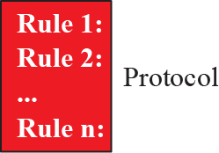
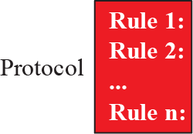
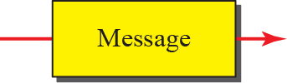


1.1.1 Components
A data communications system has five components

Slide 14
1.1.1 Components
Message
  The information to be communicated
  Text, numbers, pictures, audio, and video
Sender
  The device that sends the data message
  Computer, workstation, telephone handset video camera, and so on.
Receiver
  The device that receives the data message
  Computer, workstation, telephone handset video camera, and so on.

Slide 15
1.1.1 Components
Transmission Medium
  The physical path by witch a message travels.
  twisted pair wire, coaxial cable, fiber-optic cable, laser or wireless wave
Protocol
  A set of rules that govern data communications

Slide 16
1.1.2 Data Representation
Text : Bit Pattern, a sequence of bits (0s or 1s).
  Code : different sets of bit patterns ➔ Coding
  ASCII : American Standard Code for Information Interchange (7bit)
  Unicode uses 32 bits to represents a symbol or character
Numbers are represented by bit pattern.
Image : Pixel, Resolution
  An image is composed of matrix of pixels (picture elements).
  The size of pixel depends on the resolution.
  For black/white dots, a 1-bit pattern is enough.
  For color image, RGB or YCM (yellow, cyan, magenta)
Audio : for sound or music
Video : continuous entities

Slide 17
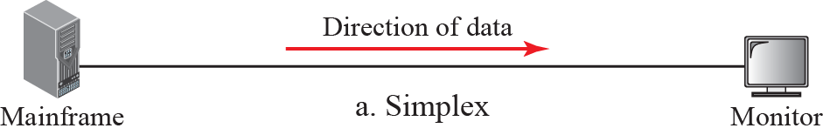
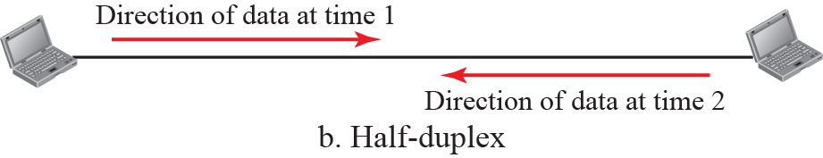
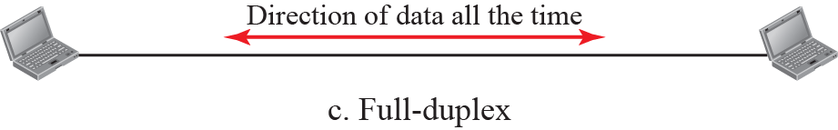
1.1.3 Data Flow
Communication between two devices can be simplex, half-duplex, or full-duplex
Keyboard, Monitor, Radio, TV
walkie-talkie
Telephone, Internet

Slide 18
1.2 Network
A network is the interconnection of a set of devices capable of communication.
  A device can be a host such as a large computer, desktop, laptop, workstation, cellular phone, or security system.
  Also, a device can also be a connecting device such as a router a switch, a modem that changes the form of data, and so on.
Node :
  We call such a device as node

Slide 19
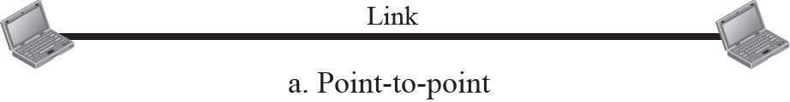
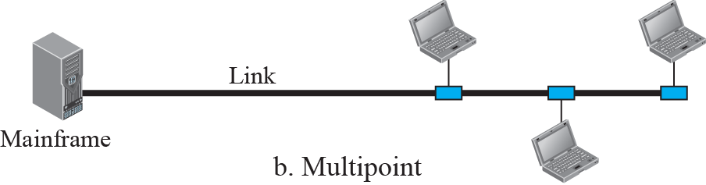
1.2.2 Physical Structures
Types of connection

Slide 20

1.2.2 Physical Structures
Physical Topology :
  The way in witch a network is laid physically.

Slide 21
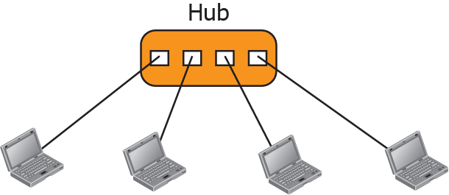
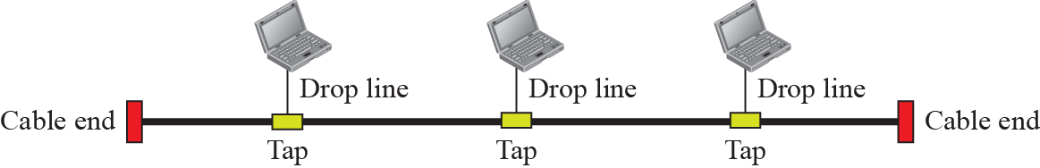
1.2.2 Physical Structures
Star Topology
Bus Topology

Slide 22
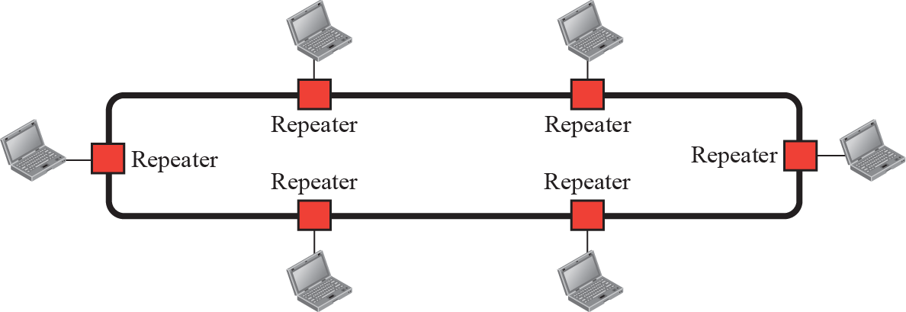
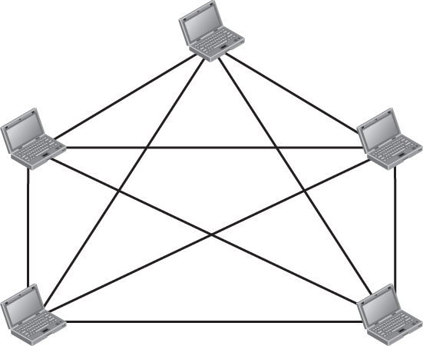
1.2.2 Physical Structures
Ring Topology
Mesh Topology

Slide 23
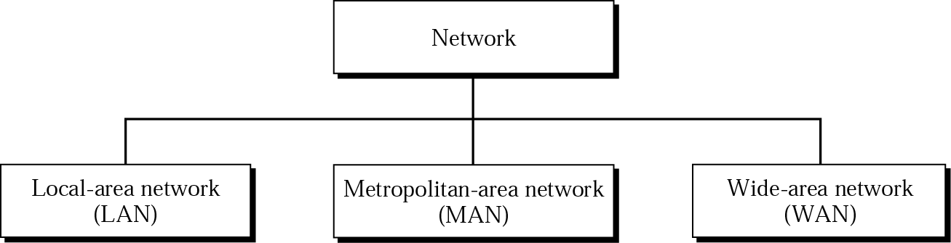
1.3 Network Type
We need to discuss different types of networks we encounter in the world today.
We use a few criteria such as size, geographical coverage, and ownership to make this distinction.

Slide 24
1.3.1 Local Area Network(LAN)
LAN is usually privately owned and connects some hosts in a single office, building, or campus.
LAN can be as simple as two PCs and a printer in someone’s home office, or it can extend throughout a company and include audio and video devices.
Each host in a LAN has an identifier, an address, that uniquely defines the host in the LAN.
A packet sent by a host to another host carries both the source host’s and the destination host’s addresses.

Slide 25
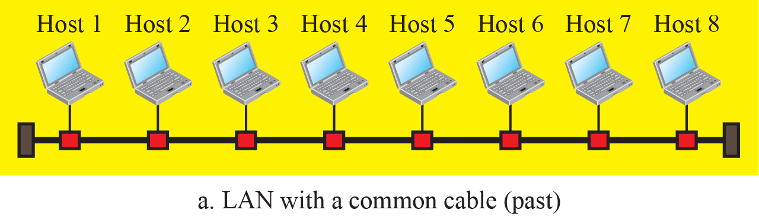
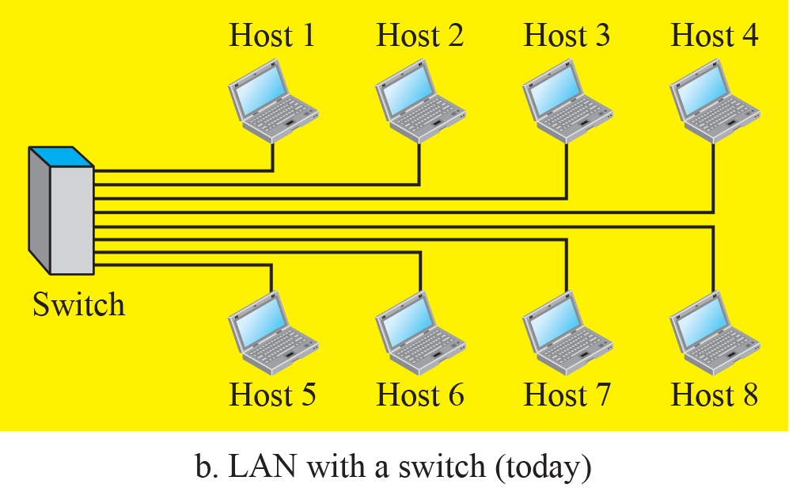
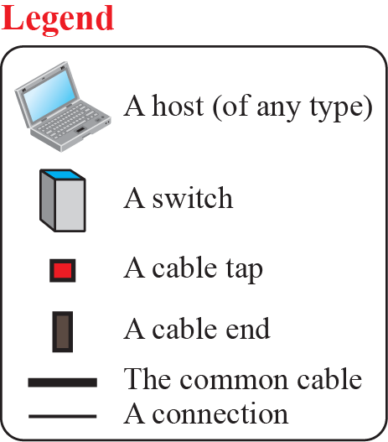
1.3.1 Local Area Network(LAN)
An Isolated LAN in the past and today

Slide 26
1.3.2 Wide Area Network(WAN)
WAN has a wider geographical span, spanning a town, a state, a country, or even the world.
  LAN is normally limited in size.
WAN interconnects connecting devices such as switches, routers, or modems.
  LAN interconnects hosts.
WAN is normally created and run by communication companies and leased by an organization that uses it.
  LAN is normally privately owned by the organization that uses it;

Slide 27
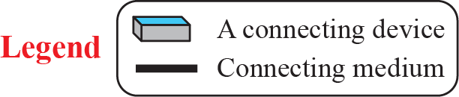
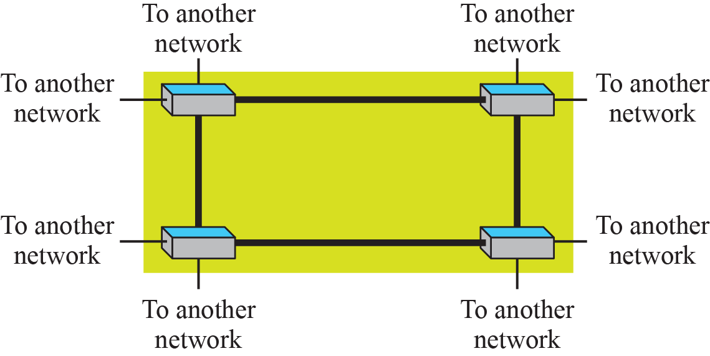
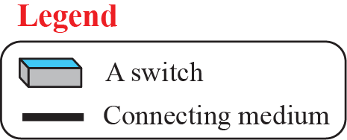
1.3.2 Wide Area Network(WAN)
Point-to-Point WAN
Switched WAN

Slide 28
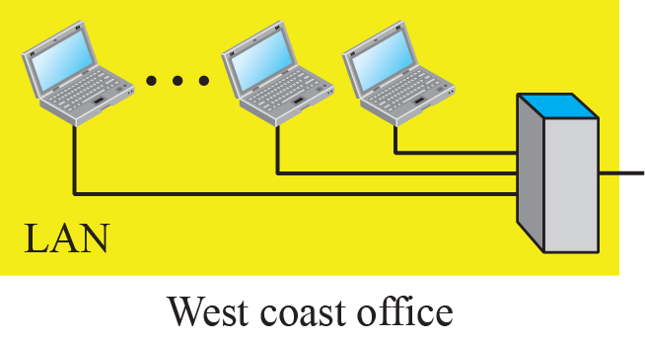
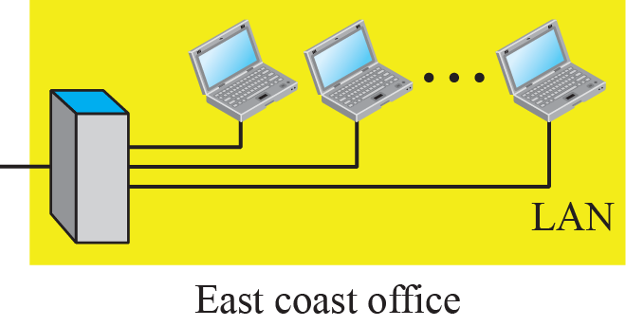
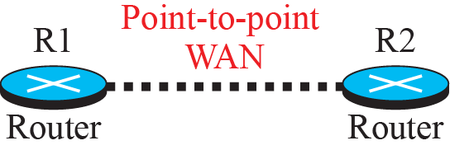
1.3.2 Wide Area Network(WAN)
An internetwork made of two LANs and one WAN

Slide 29
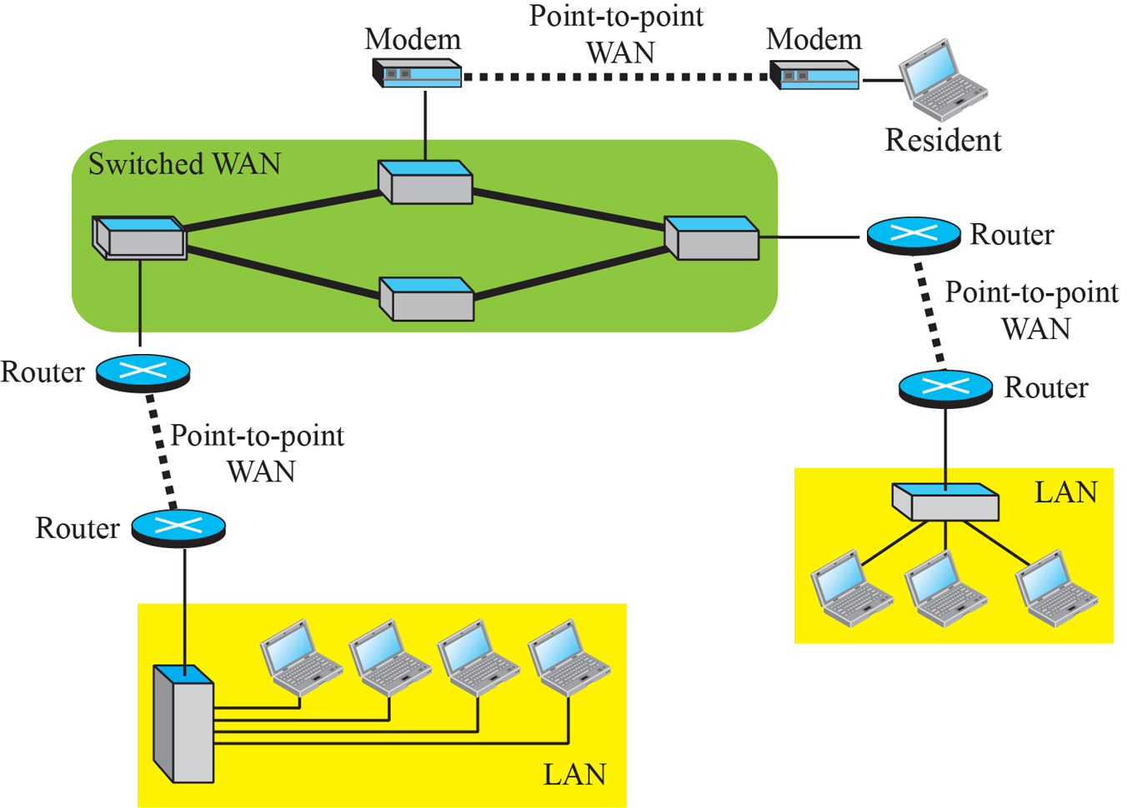
1.3.2 Wide Area Network(WAN)
A heterogeneous network made of WANs and LANs

Slide 30
1.3.3 Switching
An internet is a switched network in which a switch connects at least two links together.
A switch needs to forward data from a network to another network when required.
The two most common types of switched networks are circuit-switched and packet-switched networks.

Slide 31
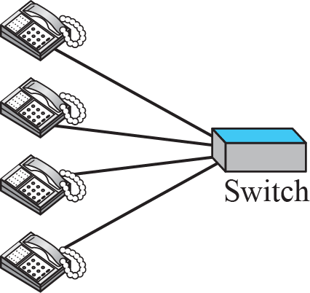

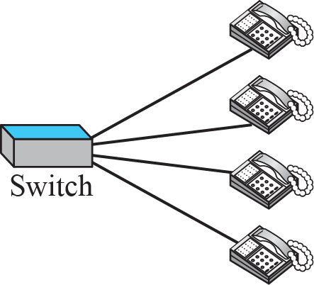
1.3.3 Switching
Circuit-Switched Network
  A dedicated connection, called a circuit, is always available between the two end systems.
  The switch can only make it active or inactive.
  Telephone network in the past.
  The part of telephone network today is packet-switched network.

Slide 32
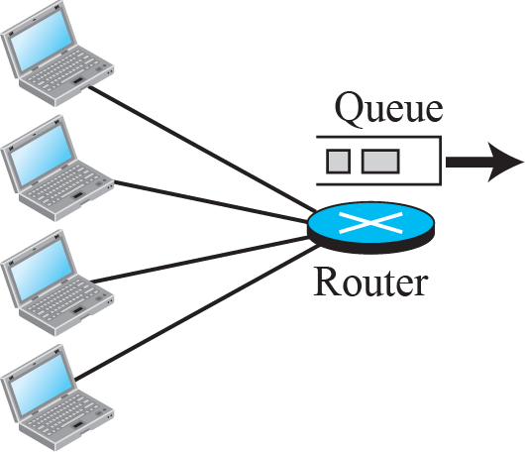
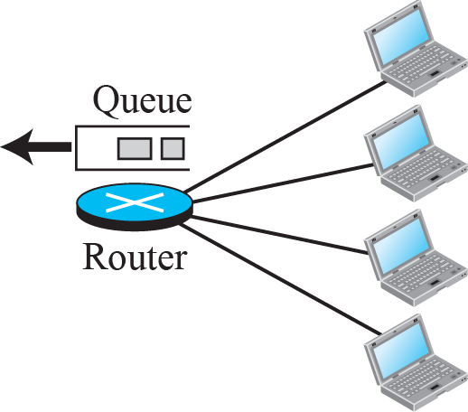

1.3.3 Switching
Packet-Switched Network
  The communication between two ends is done in blocks of data called packets.
  The exchange of packets between the two computer is possible by making the switches function for both storing and forwarding.

Slide 33
1.3.4 Internet
An internet (note the lowercase i) is two or more networks that can communicate with each other.
The most notable internet is called the Internet (uppercase I ), and is composed of thousands of interconnected networks.

Slide 34
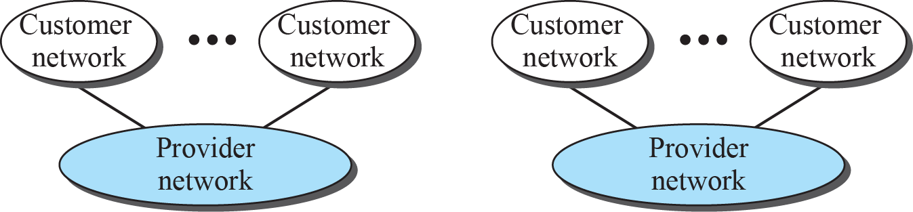
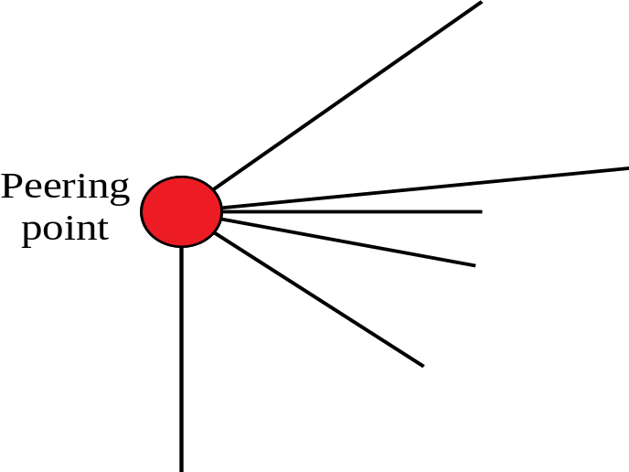

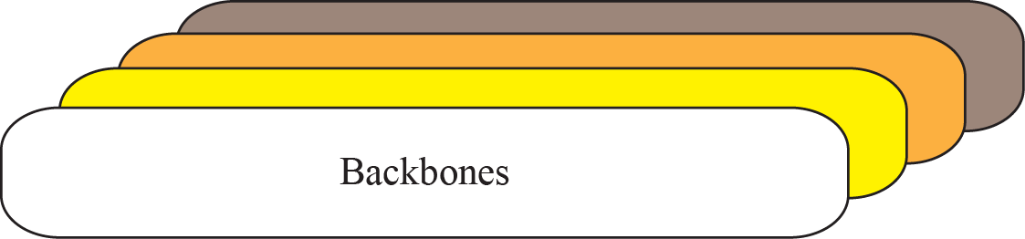
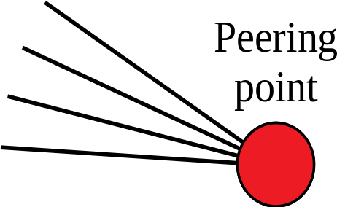

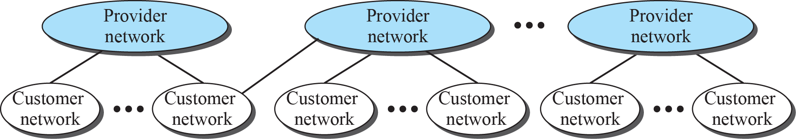
1.3.4 Internet
A conceptual (not geographical) view of the Internet.

Slide 35
1.3.4 Internet
The Internet today is an internetwork that allows any user to become part of it.
The user needs to be physically connected to an Internet Service Provider(ISP).
The physical connection is normally done through a point-to-point WAN.

Slide 36
1.3.4 Internet
Backbone
  Large networks owned by communication companies such as Sprint, Verizon, AT&T, NTT, and KT.
Provider Network
  It use the service of the backbone for a fee.
Consumer Network
  It locates at the edge of Internet, and uses its services.
Backbones and Provider Networks are called Internet Service Provider(ISP).
  Backbones are often referred to as International ISP.
  Provider Networks are often referred to as national or regional ISP.

Slide 37
1.3.5 Accessing the Internet
The Internet today is an internetwork that allows any user to become part of it.
The user needs to be physically connected to an ISP.
  Using telephone networks
  Using cable networks
  Using Wireless Networks
  Direct connection to the Internet

Slide 38
1.4 Internet History
How the Internet has evolved from a private network to a global one in less than forty years?

Slide 39
1.4. Early History
There were some communication networks, such as telegraph and telephone networks, before 1960.
  Suitable for constant-rate communication at that time.
  After a connection was made between two users, the encoded message (telegraphy) or voice (telephony) could be exchanged.
A computer network should be able to handle bursty data
  Data are received at variable rates at different times.
  The world needed to wait for the packet-switched network to be invented.

Slide 40
1.4 Birth of the Internet
In 1972, Vint Cerf and Bob Kahn, member of the core ARPANET group, collaborated on the Internetting Project.
  They wanted to link dissimilar networks so that a host on one network could communicate with a host on another.
There were many problems to overcome:
  diverse packet sizes, diverse interfaces, and diverse transmission rates, as well as differing reliability requirements.
Cerf and Kahn devised the idea of a device called a gateway.
  It serves as the intermediary hardware to transfer data from one network to another.

Slide 41
1.4.3 Internet Today
Today, we witness a rapid growth both in the infrastructure and new applications.
The Internet today is a set of pier networks that provide services to the whole world.
What has made the Internet so popular is the invention of new applications.
  World Wide Web
  Multimedia : Voice over IP, Video over IP(Skype), View Sharing (YouTube), Television over IP(PPLive))
  Peer-to-Peer Application

Slide 42
1.5.1 Internet Standard
An Internet standard is a thoroughly tested specification.
  It is useful to and adhered to by those who work with the Internet.
  It is a formalized regulation that must be followed.
There is a strict procedure by which a specification attains Internet standard status.
  A specification begins as an Internet draft.
  An Internet draft is a working document (a work in progress) with no official status and a six-month lifetime.

Slide 43
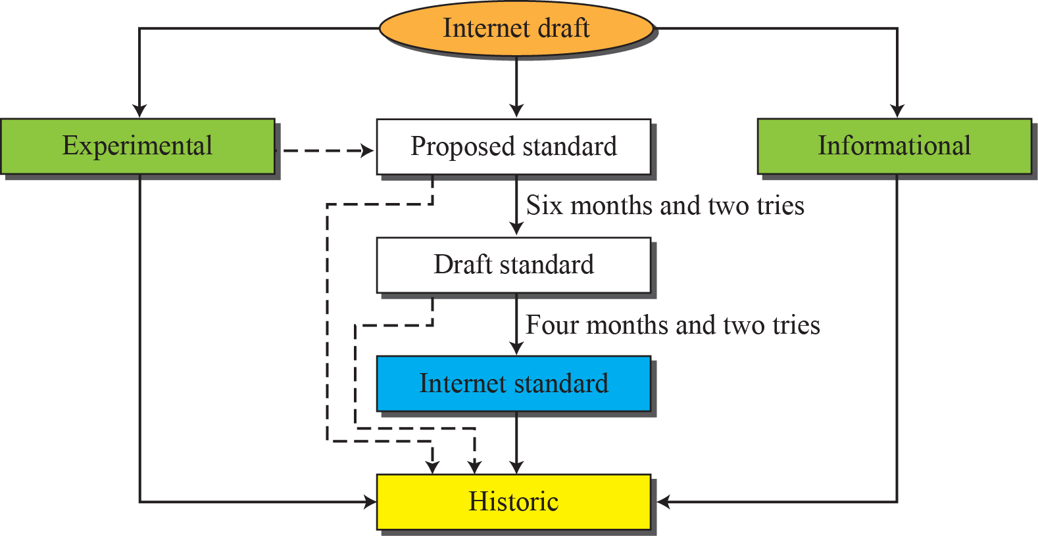
1.5.1 Internet Standard
Maturity levels of an RFC(Request For Comments)

Slide 44
1.5.2 Internet Administration
The Internet
  has its roots primarily in the research domain.
  has evolved and gained a broader user base with commercial activity.
Various groups coordinate Internet issues.
  Appendix G gives the addresses, e-mail addresses, and telephone numbers for some of these groups.

Slide 45
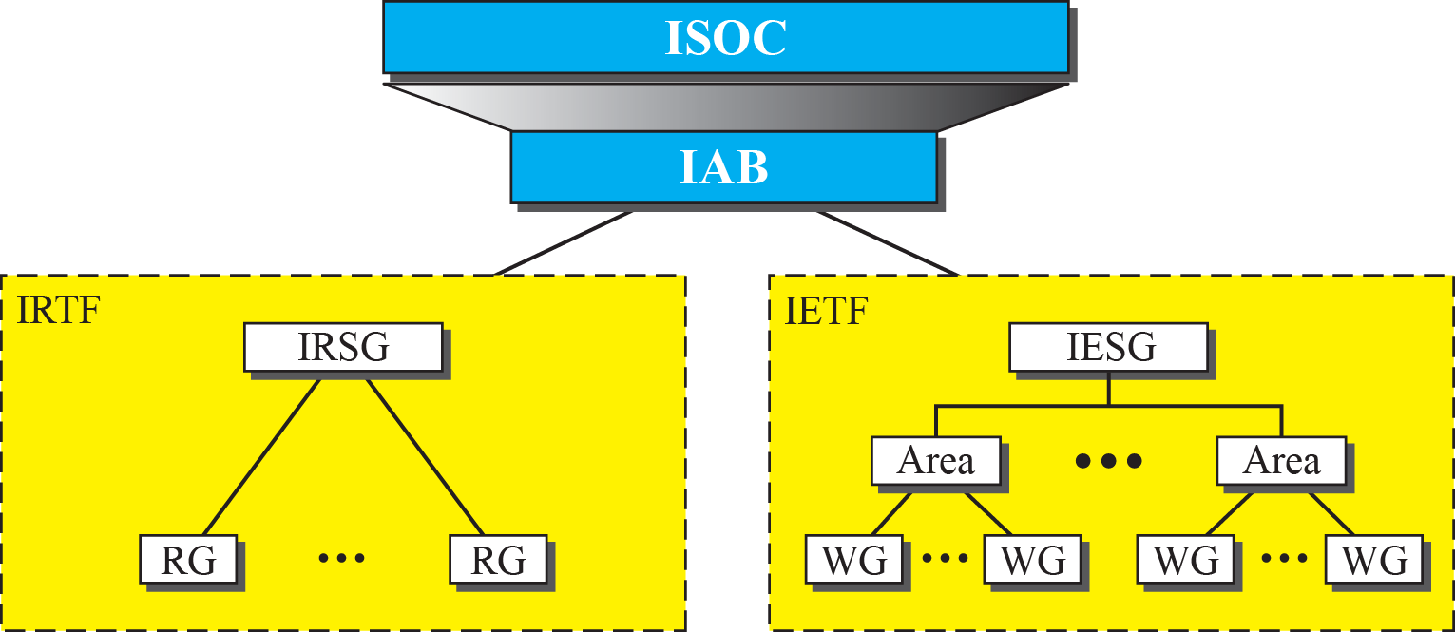
1.5.2 Internet Administration
General organization of Internet administration
  Internet Society(ISOC) is formed in 1992 to provide support for the internet standard process.
  Internet Architecture Board(IAB) is technical advisor to the ISOC.
  Internet Engineering (Research) Task Force
  Internet Engineering (Research) Steering Group

Slide 46

1.6.3 Summary
Data Communication
  Components, Data Type, Data Flow
Network Topology
  Mesh, Star, Bus, Ring
The Configuration of LAN/WAN
  Isolated LAN, Point-to-Point WAN, Switched WAN, Internet
Internet History
  Vint Cerf and Bob Kahn, collaborated on the Internetting Project in 1972.
Internet Standard
  standards and administration entities

Slide 47

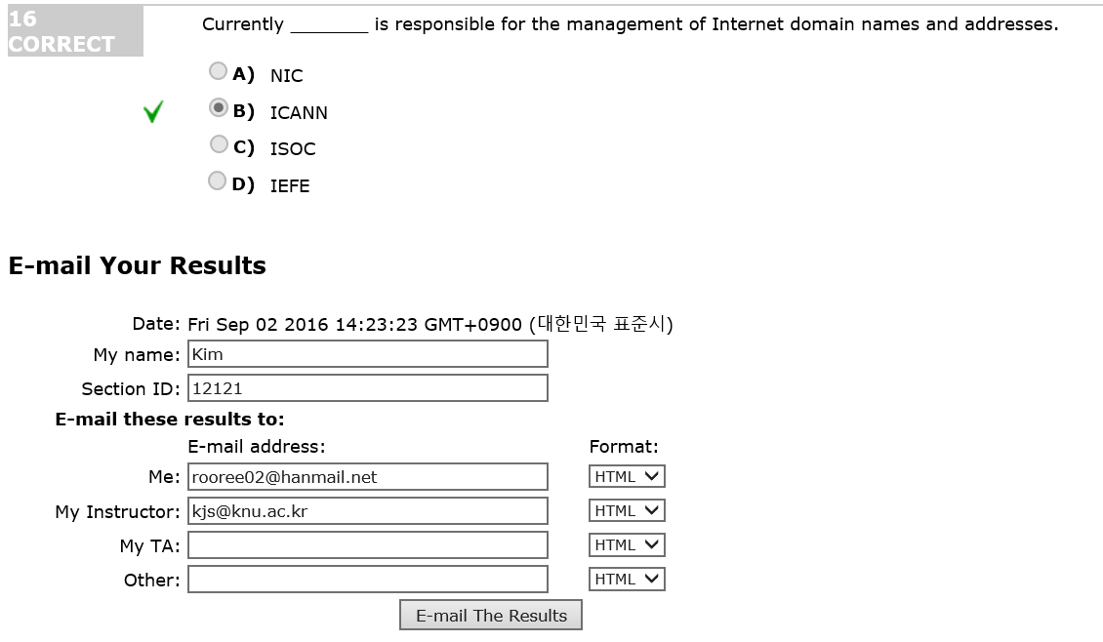
Quizzes for the Chapter
Following URL has some information for the DATA COMMUNICATION & NETWORKING, Global Edition, 5th Edition.
http://highered.mheducation.com/sites/0071315861/sitemap.html

